Slide 1
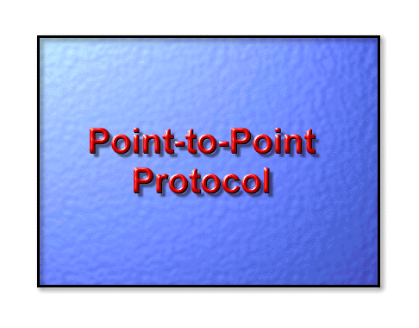

Slide 2
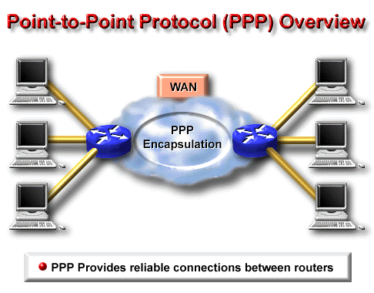
The Point-to-Point Protocol (PPP) is generally viewed as the successor to the Serial Line IP (SLIP) protocol. PPP provides router-to-router and host-to-network connections over both synchronous and asynchronous circuits.
PPP emerged in the late 1980s in response to a lack of encapsulation protocols for the Internet that was blocking growth of serial-line access. PPP was basically created to solve remote Internet connectivity problems. PPP supports a number of network layer protocols, including Novell IPX, TCP/IP and AppleTalk.

Slide 3
The Point to Point Protocol (PPP) is the most widely used Wan protocol and performs the following functions.
Link establishment - This function opens a connection or path between two routers
and negotiates how data will be sent across this network path
Link quality determination - This function will test the link to make sure that the data path is stable and reliable.
Network layer protocol configuration - This function establishes which layer 3 protocols will be sent across the data path. Since PPP can deliver multiple layer 3 protocols such as IP and IPX at the same time both sides of the connection need to know what protocols will be sent.
Link termination - This function will terminate the WAN data path between two routers.
With these processes in place data can be moved across a WAN link(s) with reliability using the PPP WAN protocol.

Slide 4
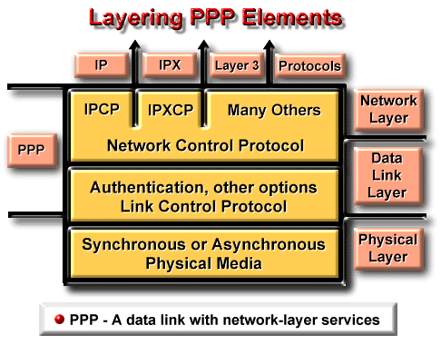
PPP uses a layered architecture. With its lower-level functions, PPP can use:
Synchronous physical media like those that connect ISDN.
Asynchronous physical media like those that use basic telephone service for modem dialup connections.
PPP offers a rich set of services that control setting up a data link. These services are options in LCP and are primarily negotiation and checking frames to implement the point-to-point controls an administrator specifies for the call
With its higher-level functions, PPP carries packets from several network-layer protocols in NCPs.

Slide 5
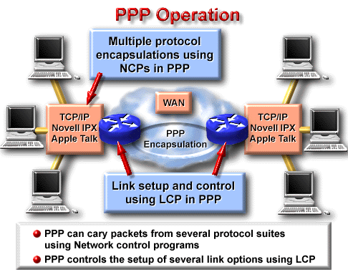
PPP runs on the following types of WAN physical interfaces:
Asynchronous serial
ISDN
Synchronous serial
PPP datagram transmission employs three key components to provide effective data transmission:
Encapsulation - PPP supports the High-Level Data Link Control (HDLC) protocol to provide encapsulation.
Link Control Protocol (LCP) - An extensible LCP is used to establish, configure, and test the data link connection.
Network Control Protocols (NCPs) - a family of NCPs are used to establish and configure different network layer protocols.

Slide 6
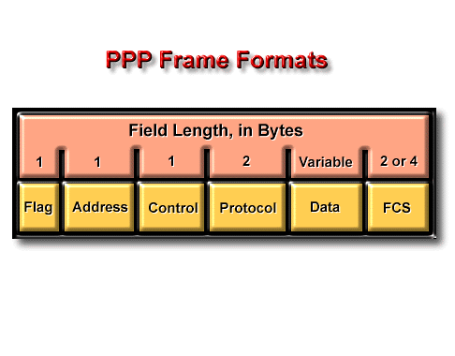
Flag - Indicates the beginning or end of a frame and consists of the binary sequence 01111110.
Address - Consists of the standard brodcast address, binary sequence 11111111. PPP does not assign individual station addresses.
Control - 1 byte that consists of the binary sequence 00000011, which calls for transmission of user data in
an unsequenced frame. A connectionless link service similar to that of Logical Link Control (LLC) Type 1 is provided.
Protocol - 2 bytes that identify the protocol encapsulated in the Information field of the frame. The most up-to-date values of the Protocol field are specified in the most recent Assigned Numbers Request For Comments (RFC).
Data - Zero or more bytes that contain the datagram for the protocol specified in the Protocol field. The end of the Information field is found by locating the closing flag sequence and allowing 2 bytes for the FCS field. The default maximum length of the Information field is 1,500 bytes. By prior agreement, consenting PPP implementations can use other values for the maximum Information field length.

Slide 7
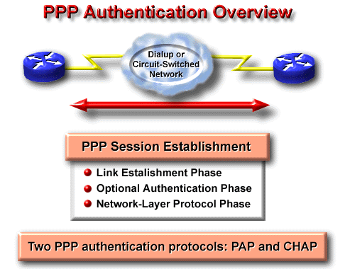
Frame Check Sequence (FCS) - Normally 16 bits (2 bytes). By prior agreement, consenting PPP implementations can use a 32-bit (4-byte) FCS for improved error detection.
Link establishment phase—In this phase, each PPP device sends LCP packets to configure and test the data link. LCP packets contain a Configuration Option field that allows devices to negotiate on the use of options such as the maximum receive unit, compression of certain PPP fields, and link authentication protocol. If a Configuration Option is not included in an LCP packet, the default value for that Configuration Option is assumed.
Authentication phase (optional)—After the link has been established, and the authentication protocol decided on, the peer may be authenticated. Authentication, if used, takes place before entering the network-layer protocol phase.
PPP supports two authentication protocols: PAP and CHAP.

Slide 8
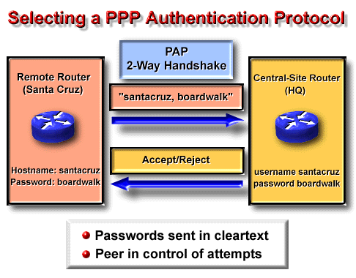
Network-layer protocol phase—In this phase, the PPP devices send NCP packets to choose and configure one or more network-layer protocol (such as IP). Once each of the chosen network-layer protocols has been configured, datagrams from each network-layer protocol can be sent over the link.
PAP provides a simple method for a remote node to establish its identity using a two-way handshake. PAP is done only upon initial link establishment.
After the PPP link establishment phase is complete, a username/password pair is repeatedly sent by the remote node to the router until
authentication is acknowledged, or the connection is terminated.
PAP is not a strong authentication protocol. Passwords are sent across the link in cleartext and there is no protection from playback or repeated trial-and-error attacks. The remote node is in control of the frequency and timing of the login attempts.

Slide 9
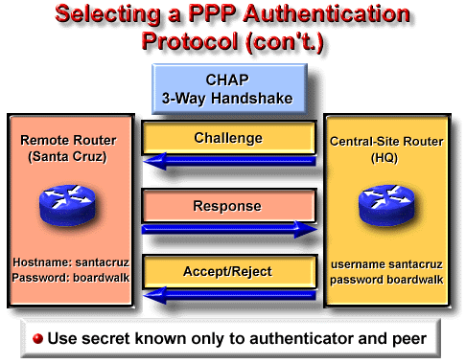
CHAP is used at the startup of a link, and periodically, to verify the identity of the remote node using a three-way handshake. CHAP is done upon initial link establishment and can be repeated any time after the link has been established.
After the PPP link establishment phase is complete, the local router sends a “challenge” message to the remote node. The remote node responds with a value calculated using
a one-way hash function (typically MD5). The local router checks the response against its own calculation of the expected hash value. If the values match, the authentication is acknowledged. Otherwise, the connection is terminated immediately.

Slide 10
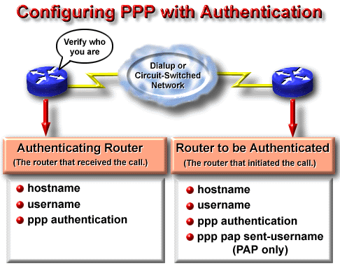
Stp 1 | On each router, define the username and password to expect from the remote router. Router(config)#username name password secret
Step 2 | Enter interface configuration mode for the desired interface.
Step 3 | Configure the interface for PPP encapsulation.
 | Router(config)#encapsulation ppp

Slide 11
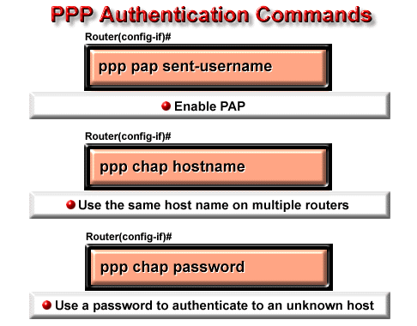
Step 4 | Configure PPP authentication. Router(config-if)#ppp authentication {chap | chap pap | pap chap | pap}
Step 5 | If both methods are enabled, then the first method specified will be requested during link negotiation. If the peer suggests using the second method or
simply refuses the first method, then the second method will be tried.
Step 6
Router(config-if)#ppp pap sent-username username password pass
The following commands can be used to simplify CHAP configuration tasks on the router:
Router(config-if)#ppp chap hostname hostname
Router(config-if)#ppp chap password secret

Slide 12
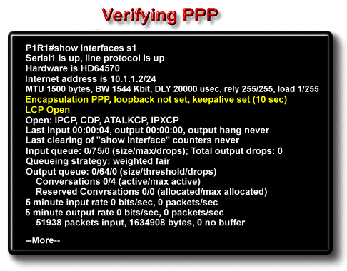

Slide 13
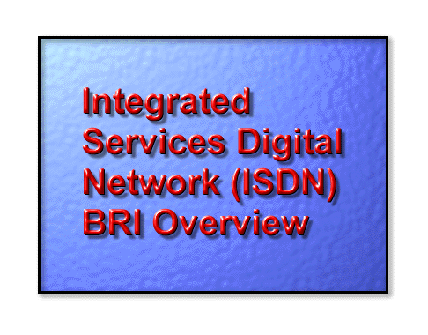

Slide 14
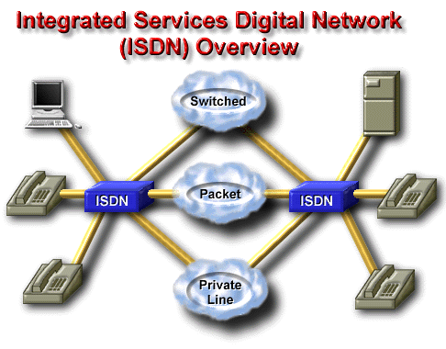
Integrated Services Digital Network (ISDN) refers to a set of communication protocols proposed by telephone companies to permit telephone networks to carry data, voice, and other source material.

Slide 15
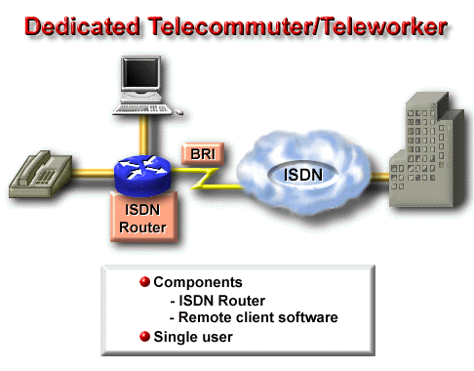
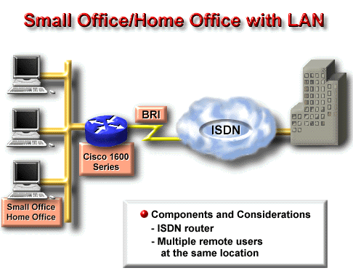
The full-time telecommuter/teleworker is one that normally works out of the home. This user is more of a power user that needs access to the enterprise networks for a longer period of time. This connection should be reliable and available at all times. Such a requirement would generally point to ISDN as the connection method.

Slide 16
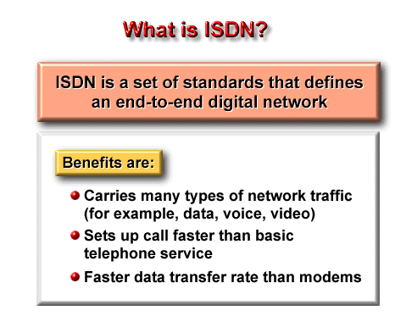
ISDN stands for Integrated Services Digital Network. It refers to a collection of standards that provide an integrated voice/data capability to the customer premises facility, utilizing the public switched network. The ISDN standards define the hardware and call setup schemes for end-to-end digital connectivity.
Bringing digital connectivity via ISDN to the local site has many benefits including:
The ability to carry a variety of user-traffic feeds. ISDN provides access to all-digital facilities for video, packet-switched data, and telephone network services.
Much faster call setup using out-of-band (D, or delta, channel) signaling than modem connections. For example, a duration of less than one second can be sufficient to make some ISDN calls.
Much faster data transfer rate using bearer (B) channel services at 64 kbps per channel as opposed to common modem alternatives of 28.8 kbps.

Slide 17
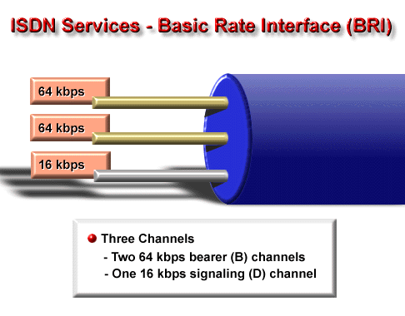
There are two ISDN services—Basic Rate Interface (BRI) and Primary Rate Interface (PRI). ISDN BRI operates over most of the copper twisted-pair telephone wiring in place today. ISDN BRI delivers a total bandwidth of a 144-kbps line into three separate channels. Two of the channels, called B (bearer) channels, operate at 64 kbps and are used to carry voice or data traffic.
The third channel, the D (data) channel, is a 16-kbps signaling channel used to carry instructions that tell the telephone network how to handle each of the B channels. ISDN BRI is often referred to as “2B+D.”

Slide 18
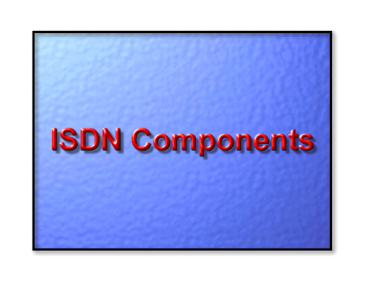

Slide 19
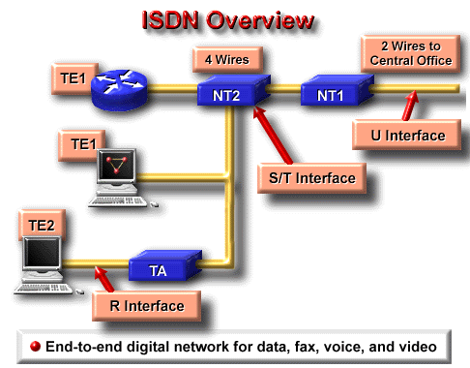
ISDN devices include the following:
Terminal Equipment 1 (TE1) - Designates a device that is compatible with the ISDN network. A TE1 connects to a Network Termination of either Type 1 or Type 2.
Terminal Equipment 2 (TE2) - Designates a device that is not compatible with ISDN and requires a Terminal Adapter.
Terminal Adapter (TA) - Converts standard electrical signals into the form used by ISDN so that non-ISDN devices can connect to the
ISDN network.
Network Termination Type 1 (NT1) - Connects 4-wire ISDN subscriber wiring to the conventional 2-wire local loop facility.
Network Termination Type 2 (NT2) - Directs traffic to and from different subscriber devices and the NT1. The NT2 is an intelligent device that performs switching and concentrating.
The S/T interface defines the interface between a TE1 and an NT. The S/T is also used to define the TA-to-NT interface.
The R interface defines the interface between a TE2 and the TA.
The U interface defines the 2-wire interface between the NT and the ISDN “cloud."

Slide 20
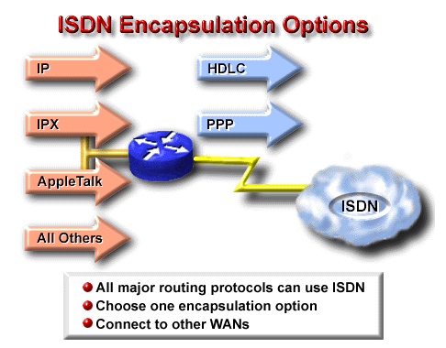
As its configured encapsulation, ISDN defaults to HDLC. Alternatively, Point-to-Point Protocol (PPP) can also be used. With PPP, you can enable the Challenge Handshake Authentication Protocol (CHAP), a popular, authentication protocol for call screening. Among the other encapsulations for end-to-end ISDN is LAPD.
ISDN interfaces allow only a single encapsulation type

Slide 21
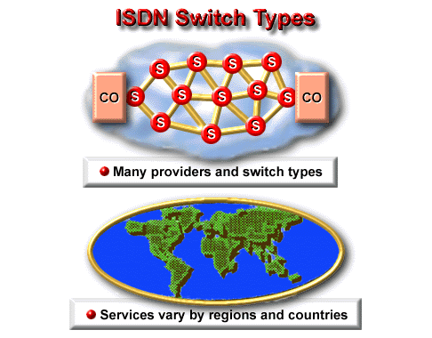
As a result, before you can connect your router to an ISDN service, you must be aware of the switch types used at the CO.
CO - Central office. Local telephone company office to which all local loops in a given area connect and in which circuit switching of subscriber lines occurs.
SPID - Service Profile Identifier. Number that some service providers use to define the services to which an ISDN device subscribes. The ISDN device uses the SPID when accessing the switch that initializes the connection to a service provider. The SPIDs are processed during each call setup operation.

Slide 22
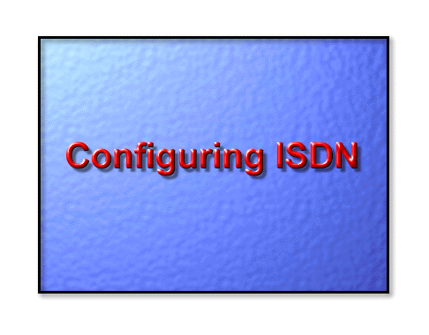

Slide 23
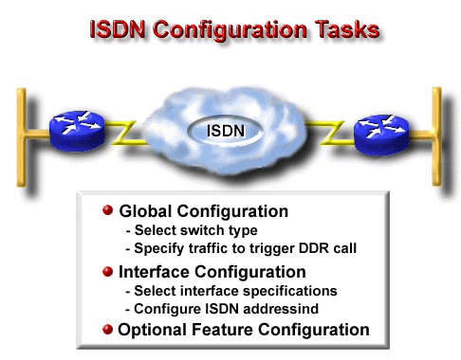

Slide 24
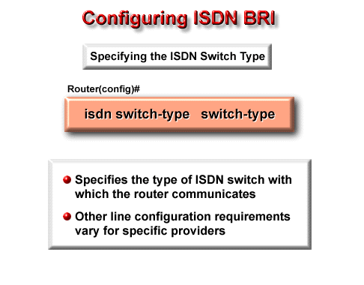
Step 1 - Selecting the ISDN Switch Type
Switch Type | Description
basic-5ess | AT&T basic rate switches (USA)
basic-dms100 | NT DMS-100
basic-ni1 | National ISDN-1 (North America)
basic-1tr6 | German 1TR6 ISDN switches
basic-ts013 | Australian TS013 switches
basic-net3 | Switch type for Net3 in United Kingdom and Europe
ntt | NTT ISDN switch Japan
none | No specific switch specified

Slide 25
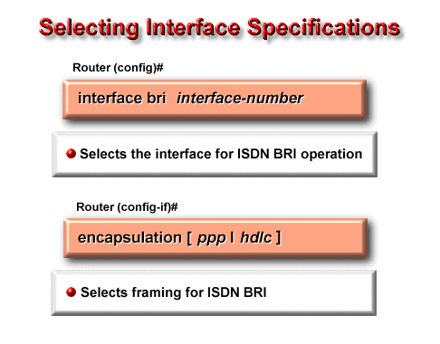
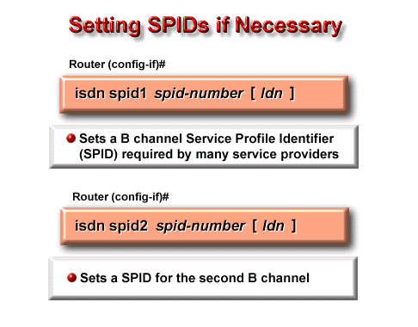
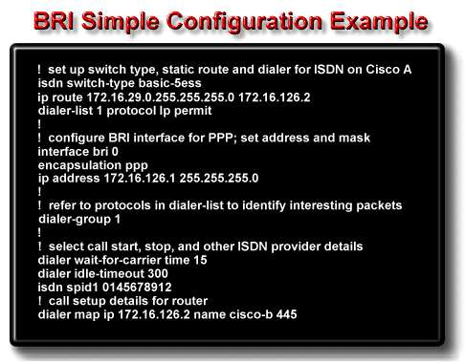

Slide 26
Command | Description
isdn switch-type | Selects the AT&T switch as the CO ISDN switch type for this router.
dialer-list 1 protocol ip permit | Associates permitted IP traffic with the dialer group 1. The router will not start an ISDN call for any other packet traffic with dialer group 1.
interface bri 0 | Selects interface with TA and other ISDN functions on the router.
encapsulation ppp | Use PPP encapsulation on the selected interface.
dialer-group 1 | Associates the BRI 0 interface with dialing access group 1.
dialer wait-for-carrier-time | Specifies a 15-second maximum time for the provider to respond once the call initiates.
dialer idle-timeout 10000 | Number of seconds of idle time before the router drops the ISDN call. Note that a long duration is configured to delay termination.

Slide 27
